Slide 1
Introduction to Git
Lesson 01 : Getting Started with Git

Slide 2
Lesson Objective
In this lesson, you will learn:
Introduction to Git
Creating Git repository
Understanding local and remote repository
Committing changes to the repository
Forking the repository
Branching the repository
Merging the changes back to the primary repository.
Viewing logs
Creating Azure DevOps account
Creating & Collaborating with Azure DevOps repository

Slide 3
Introduction
What is Source Control?
Source control helps team manage changes to source code over time.
What is Version Control?
The term version control is used interchangeably with source control.
Difference between source control and version control:
Source control is specific to source code, where as version control also covers large binary files and digital assets.

Slide 4
Introduction
What is source control management?
Source control management (SCM) refers to tools that helps software team manage changes to source code over time.
Version control software keeps track of every modification to the code in a special kind of database.
Software teams that do not use any form of version control often run into problems like not knowing which changes that have been made are available to users or the creation of incompatible changes between two unrelated pieces of work that must then be painstakingly untangled and reworked.

Slide 5

What is Git?
By far, the most widely used modern version control system in the world today is Git.
Git is a mature, actively maintained open source project originally developed in 2005 by Linus Torvalds, the famous creator of the Linux operating system kernel.
Unlike CVS or SVN (Subversion), Git is a DVCS (Distributed Version Control System).
In addition to being distributed, Git has been designed with performance, security and flexibility in mind.

Slide 6
Benefits of Git
Complete long term change history of every file is maintained.
Multiple independent streams of work can co-exist with branches.
Distributed Version Control System (DVCS).
Performance of Git is very strong when compared to many alternatives.
Git repository are secured with a cryptographically secure hashing algorithm called SHA1.
Open source

Slide 7
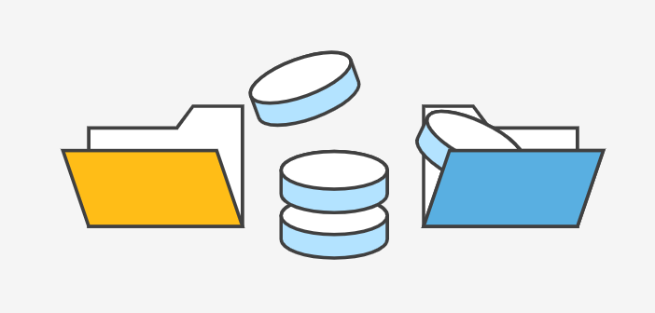
Installing Git
Installing Git on Windows:
Download the latest Git from https://gitforwindows.org/
When you've successfully started the installer, you should see the Git Setup wizard screen. Follow the Next and Finish prompts to complete the installation. The default options are pretty sensible for most users.

Slide 8



Basic Commands
Open a Command Prompt (or Git Bash if during installation you elected not to use Git from the Windows Command Prompt).
Checking the installed version:
Setting username and email:
Verifying username and email:

Slide 9
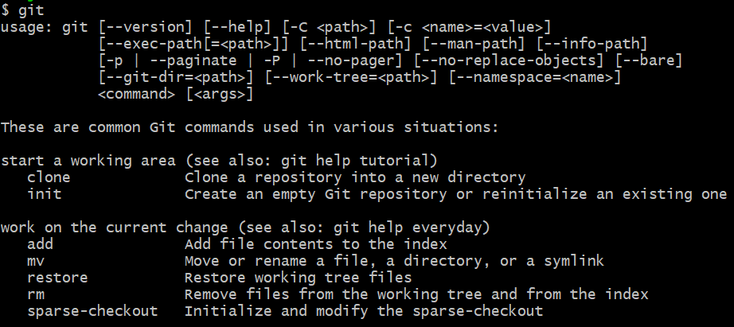
Basic Commands (Cont.…)
git and get help: Both commands are same.
get help init: Offers browser based help.

Slide 10


Creating new local git repository
Step1. Open up your project folder, and navigate into the same.
For checking your current location:
Identify location of repository and navigate:
Create new directory to make it as repository and navigate to it.
Initialize directory as git repository:
After repository is created, then observe that now prompt is showing it as master, as shown below:

Slide 11
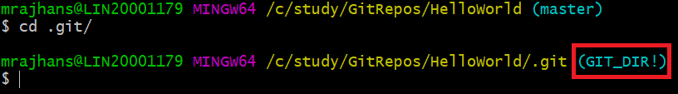
.git folder in repository
The . git folder contains all the information that is necessary for your project in version control and all the information about commits, remote repository address, etc. All of them are present in this folder. It also contains a log that stores your commit history so that you can roll back to history.
Viewing .git directory:
Change the directory to .git:

Slide 12
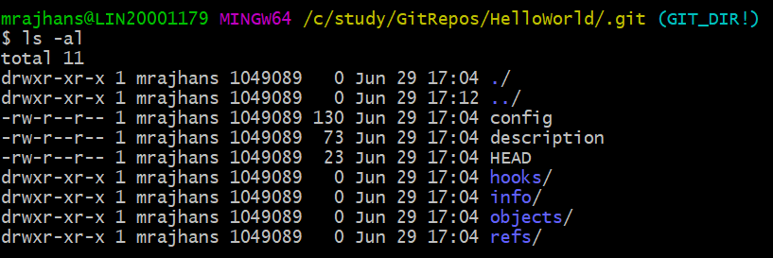
.git folder in repository (cont.…)
.git folder contains the following information. You can view the available file and folders with following command.

Slide 13

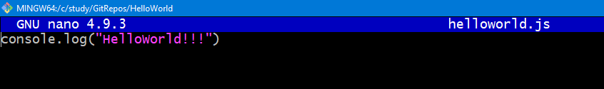
Adding new file to git repository
Create file in the current folder / repo:
This will open the file in edit mode, as shown below. You can write anything into it.
Press Ctrl+X to close and press Y to save changes.

Slide 14
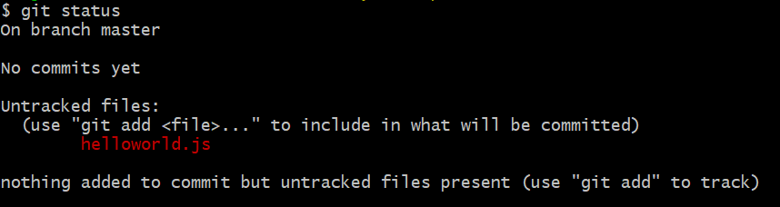
Git status
To check status of repository, type command, git status:

Slide 15
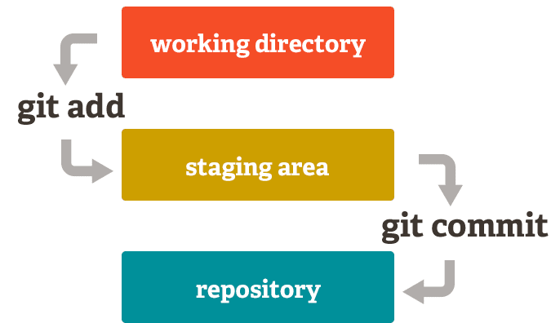
Working directory, staging area and repository

Slide 16
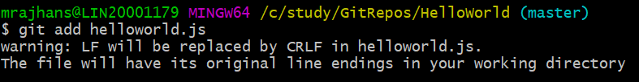
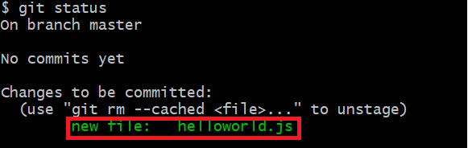
Adding file into staging area
To add file from working directory to the staging area we can use git add command.
Checking status after adding file in staging area:

Slide 17
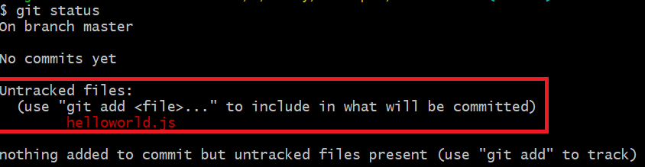
Removing file from staging area
To remove file from staging area and put it back into the working directory, use git reset command.
To add the file again in staging area, use git add command.

Slide 18
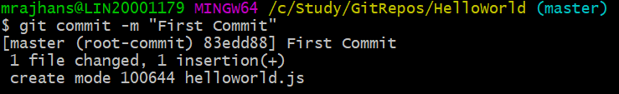

Committing changes to the local repository
When commit command is used all the tracked changes will be committed/ reflected to the repository.
To commit the files from staging area to local repository, use git commit command.
Status after commit:

Slide 19

Creating repository in the existing working directory
You can download the sample repository from shared material.
Copy the folder and navigate to it.
Now, initialize the directory as a git repository.
add all the existing files from the working directory into staging area with git add command.

Slide 20
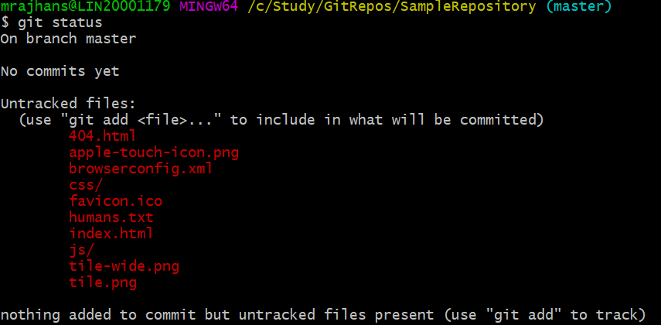
Creating repository in the existing working directory (Cont.…)
Now, check the status of created repository.
add all the existing files from the working directory into staging area with git add command.

Slide 21
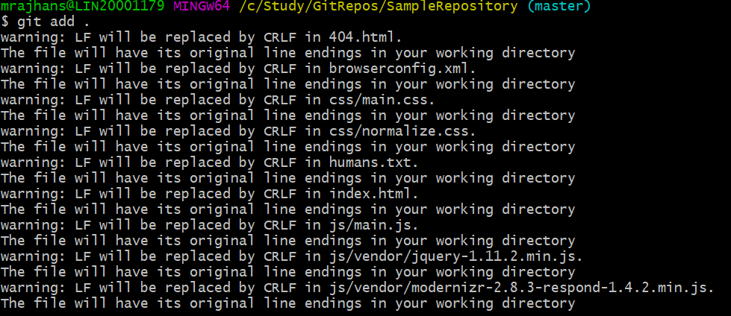
Creating repository in the existing working directory (Cont.…)
Now add all the existing files from the working directory into staging area with git add command.

Slide 22
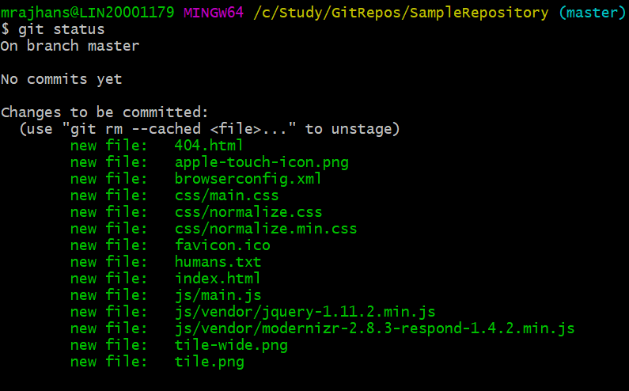
Creating repository in the existing working directory (Cont.…)
After checking status, it shows the status as files are added in staging area .

Slide 23
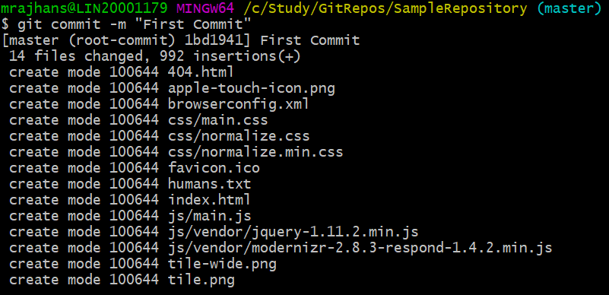
Creating repository in the existing working directory (Cont.…)
Once files are added in staging area, commit the files into local repository.

Slide 24

Creating repository in the existing working directory (Cont.…)
Now all the files in working directory are in synch with files from working directory. Check the status of the same.

Slide 25
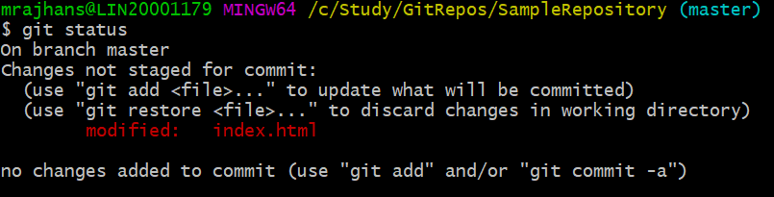
Modifying the files in the local repository
Modify file index.html.
Check the status, now it shows the status of index file as modified.

Slide 26

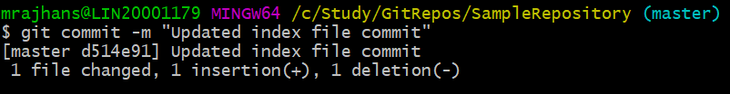
Modifying the files in the local repository (Cont.…)
Add the updated index file into staging area..
Now commit the files.

Slide 27
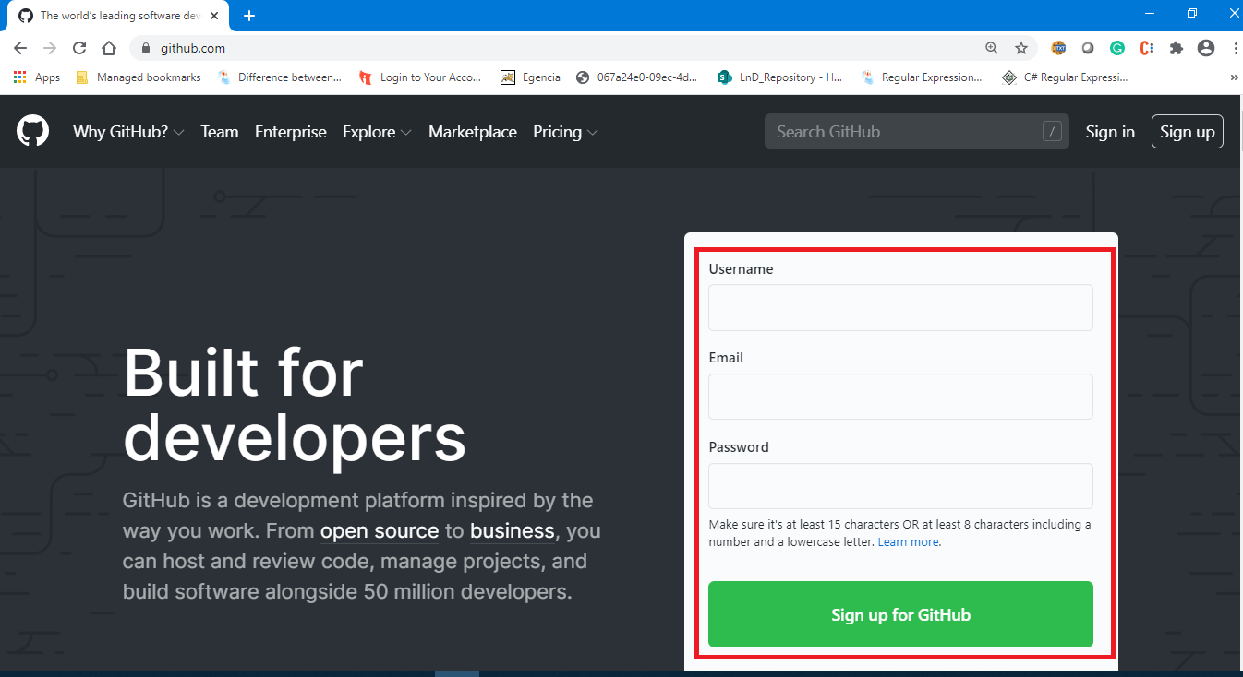
Creating remote repository on GitHub
Navigate to Github.com and register on the site.

Slide 28
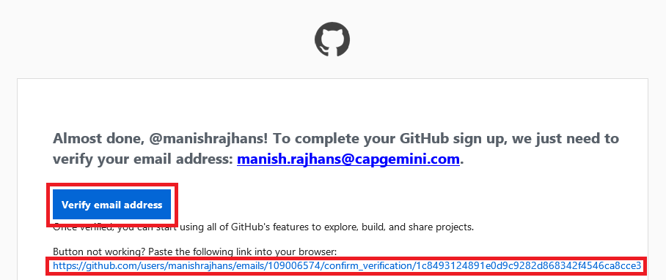
Creating remote repository on GitHub (Cont.…)
After registration, you will receive an email to verify your email address. Click on Verify Button.

Slide 29
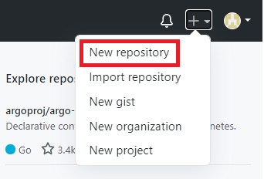
Creating remote repository on GitHub (Cont.…)
After email verification, sign in to the GitHub and now click on create repository.

Slide 30
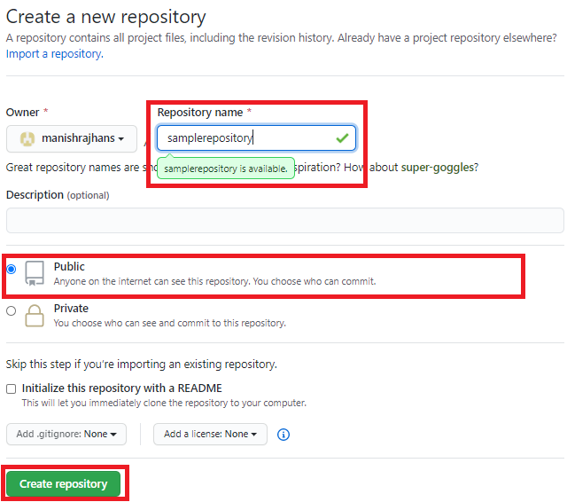
Creating remote repository on GitHub (Cont.…)
After clocking on New repository, fill out the below form as below.

Slide 31
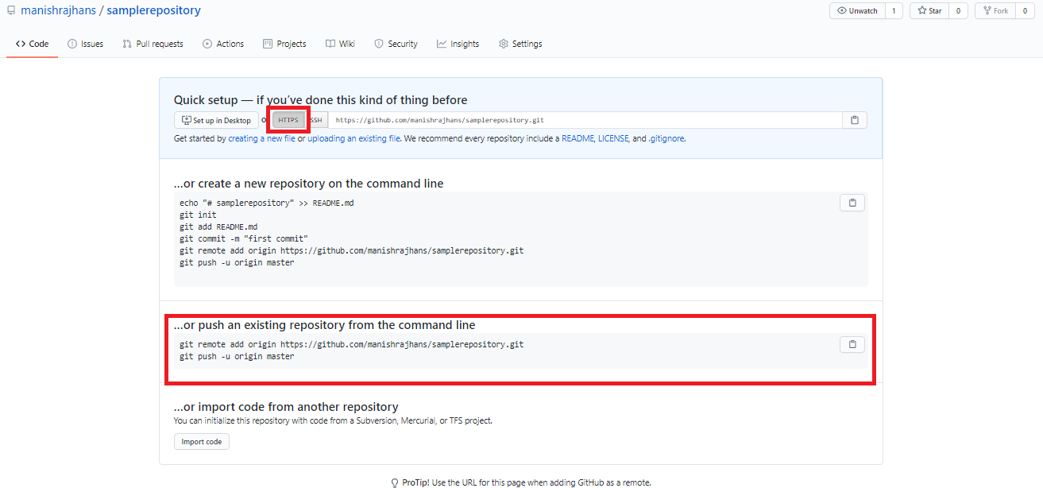
Creating remote repository on GitHub (Cont.…)
After clicking on Create repository, repository will get created and you will see below details. These details can be used to map local repository with this GitHub repository.

Slide 32
Mapping local repository with GitHub repository
Use the command git remote as specified on the GitHub to map the local repository with the GitHub repository as below:

Slide 33
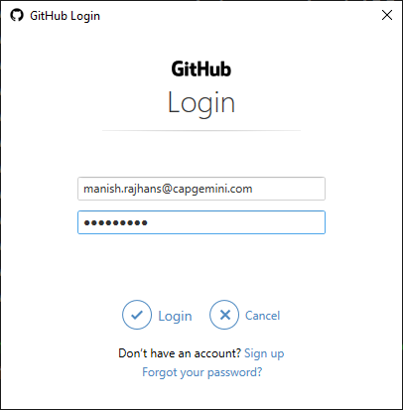
Pushing the changes from local repository to GitHub
Use the command git push as below:
For the first time push, it will ask you for username and password, provide them correctly.

Slide 34
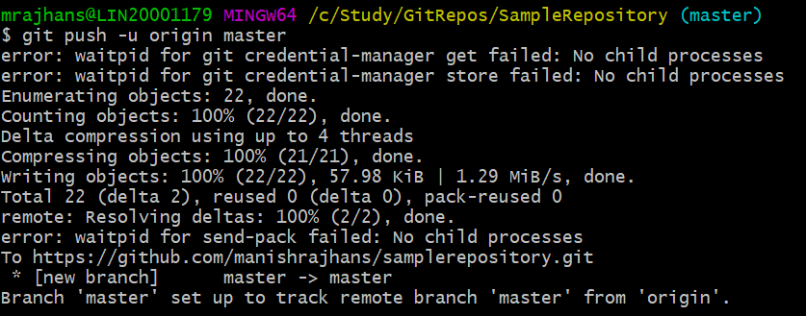
Pushing the changes from local repository to GitHub (Cont.…)
After this, all the changes will be written to GitHub.

Slide 35
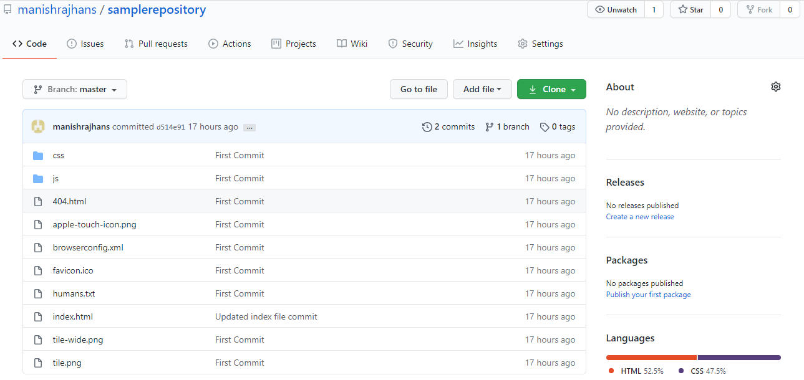
Pushing the changes from local repository to GitHub (Cont.…)
Now refresh the GitHub page, and you will see all the files from local repository are now pushed into GitHub repository.

Slide 36
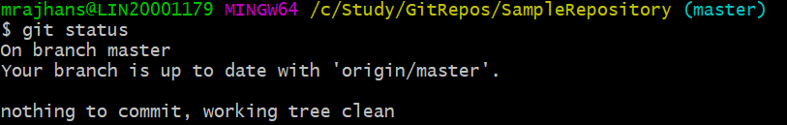
Pushing the changes from local repository to GitHub (Cont.…)
If you check the status now, it shows that your branch is up-to-date.

Slide 37
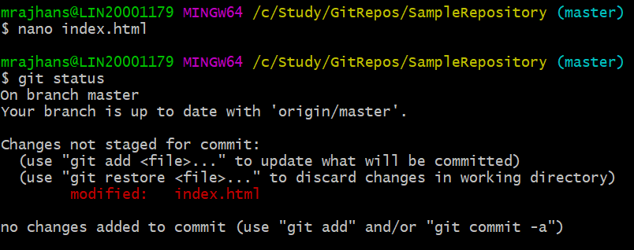
Modifying files on local repository
If you check the status now, it shows that your branch is up-to-date.

Slide 38

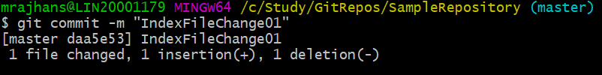
Committing files on local repository
Now you can add files into staging area.
Committing changes to repository from staging area.

Slide 39
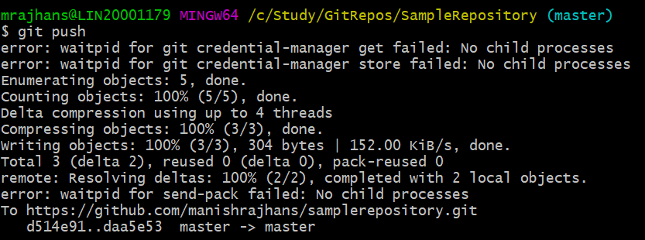
Pushing committed files to GitHub repository
This time, you can run the push command, and it will not ask you for credentials.

Slide 40
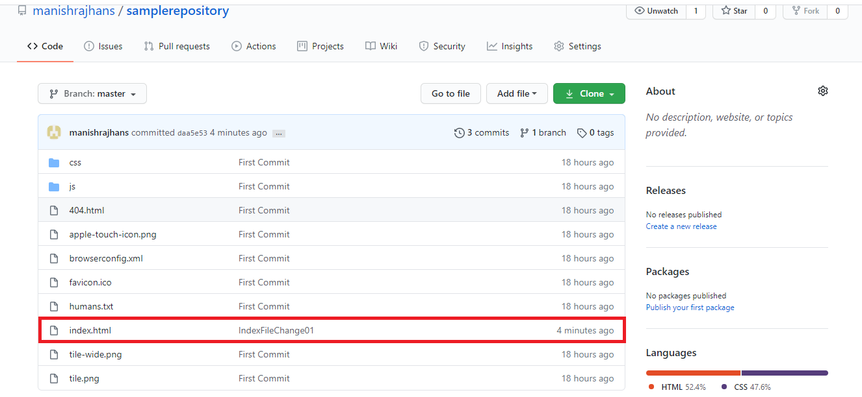
Pushing committed files to GitHub repository (Cont.…)
You can observe the changes into the GitHub repository as well.

Slide 41
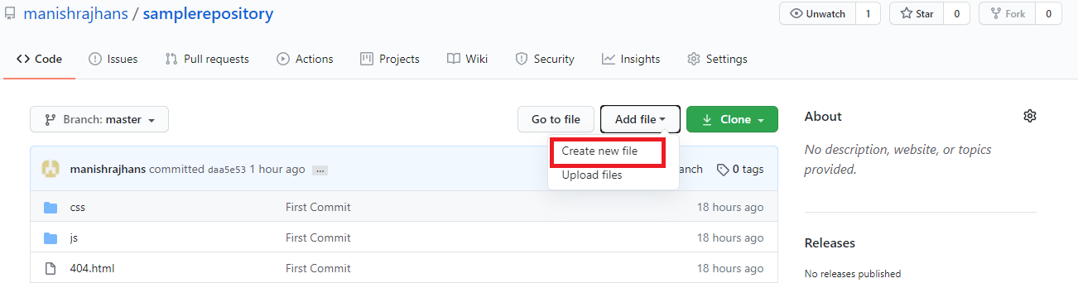
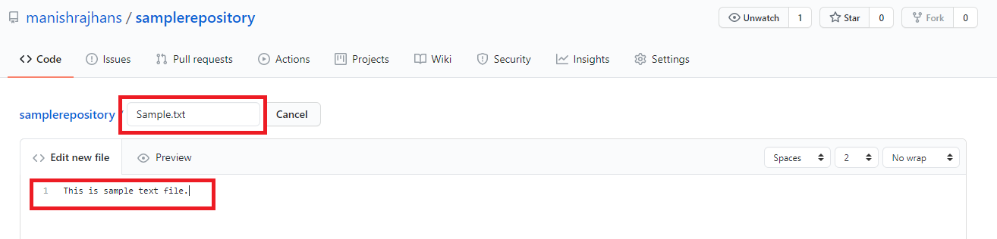
Adding files into GitHub repository
Click on Add File, then click on Create new file.
Give name to the file, and put some content into it.

Slide 42
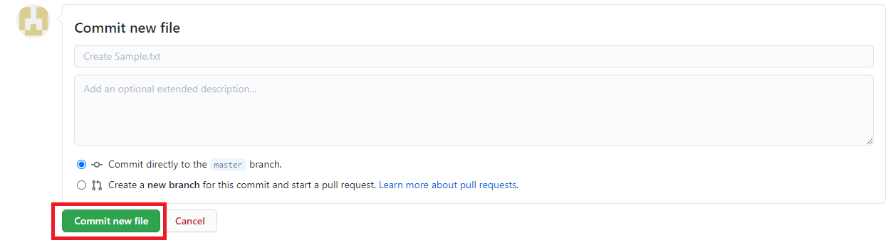
Adding files into GitHub repository (Cont.…)
Commit the changes into master branch.

Slide 43
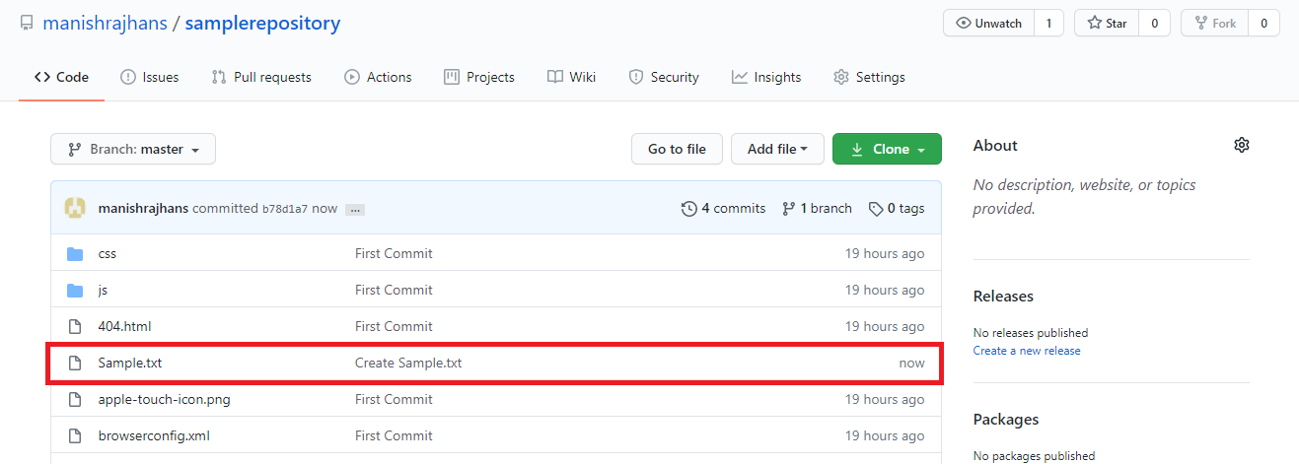
Adding files into GitHub repository (Cont.…)
Newly created file is now available on GitHub repository.

Slide 44
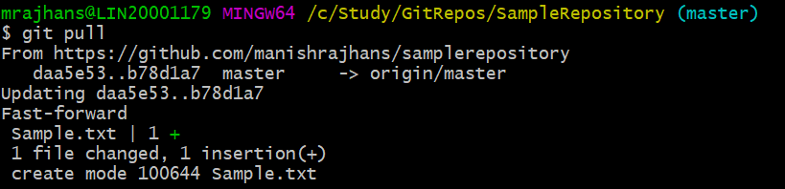
Getting changes from GitHub repository to local repository
Changes in GitHub repository can be pulled in local repository with pull command.

Slide 45
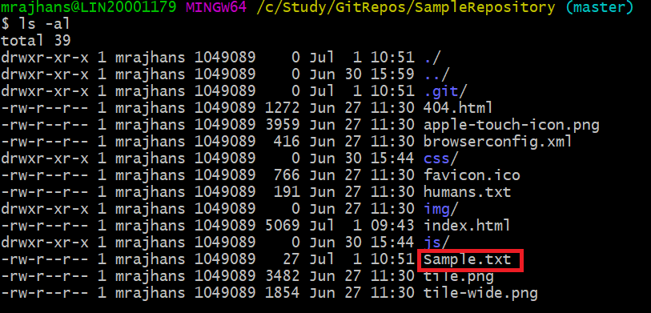
Getting changes from GitHub repository to local repository
Check whether the file has been pulled.

Slide 46
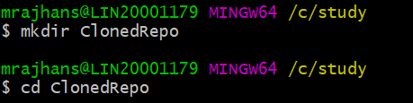
Cloning the repository
clone is primarily used to point to an existing repo and make a clone or copy of that repo at in a new directory, at another location, the original repository can be located on the local filesystem or on remote machine accessible supported protocols.
Create another directory than existing repository and navigate to it.

Slide 47
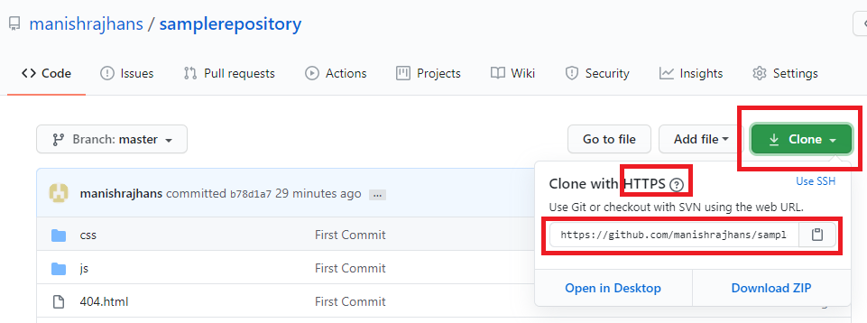
Cloning the repository (Cont.…)
Now clone the repository into this newly created repository.

Slide 48
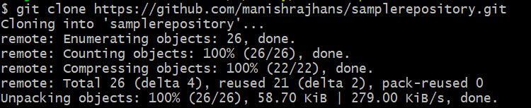
Cloning the repository (Cont.…)
Now in GitBash or command prompt run following command.
It will clone the remote repository into the selected directory.

Slide 49
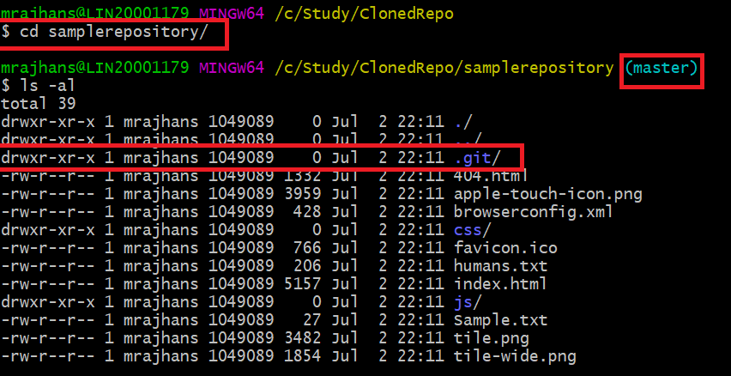
Cloning the repository (Cont.…)
Now check the cloned samplerepository.
Notes:
Incase while cloning if you get an error, try running the GitBash with Admin access.

Slide 50
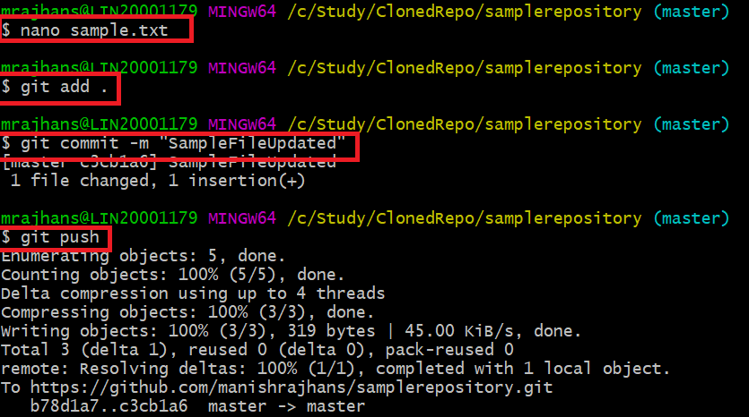
Cloning the repository (Cont.…)
Edit the file sample.txt from the cloned repository, now add it to staging area. After that commit the changes and push them to remote repository.
Notes:
Incase while cloning if you get an error, try running the GitBash with Admin access.

Slide 51
Cloning the repository (Cont.…)
Now check the cloned sample repository.

Slide 52
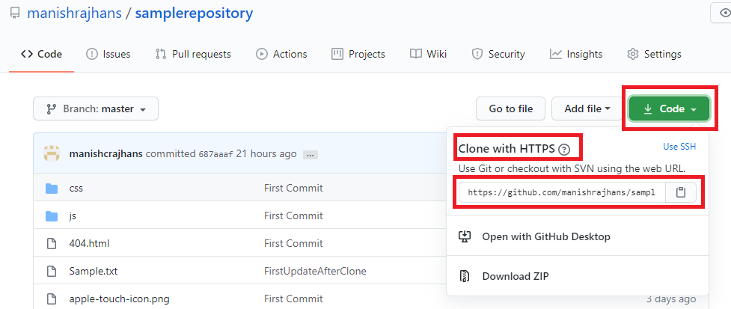
Cloning the other users repository
To clone the other user’s repository, click Code, and ensure you have selected clone with HTTPS.

Slide 53
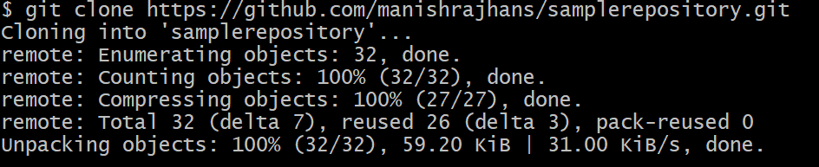
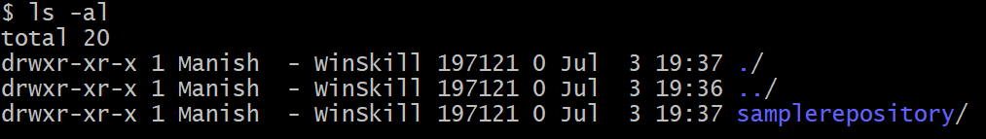
Cloning the other users repository (Cont.…)
Now on your machine, you need to create and choose directory in which you want to clone the directory and clone the repository with the path that you have copied.
Now you can check that cloned sample directory is added on your machine.

Slide 54
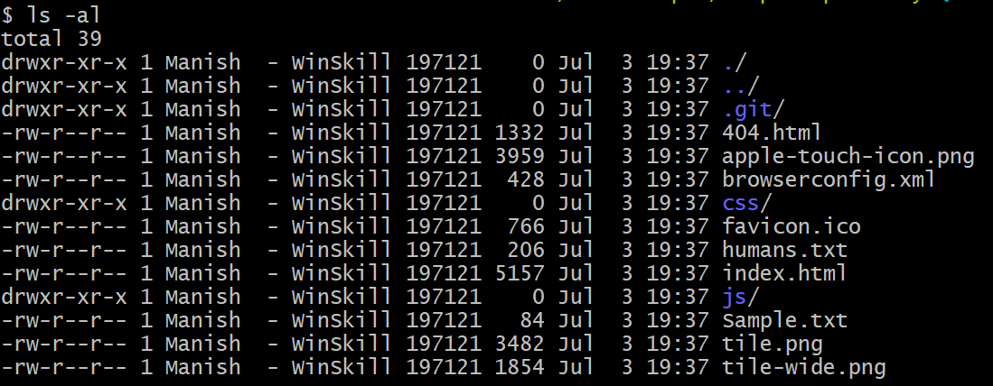
Cloning the other users repository (Cont.…)
Navigate to the directory.
You can now check the content of directory which is exact copy of the repository we cloned..

Slide 55


Cloning the other users repository (Cont.…)
We will make the changes to Sample .txt file, hence open it and make some changes..
After making changes, add files into staging area.
Now commit the changes to the local repository.

Slide 56
Cloning the other users repository (Cont.…)
Finally push the changes to the repository.
As you are not the owner of this repository, you are not allowed to push any changes to this repository hence you will get an error.
To collaborate to this repository, you need to fork the repository.

Slide 57
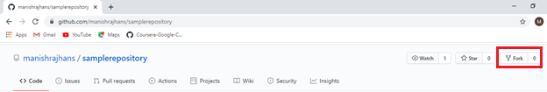
Forking the repository
To fork the repository, navigate to the URL of repository. After navigating to URL, Click on fork button as shown below.
After you click on fork, it will open new page.

Slide 58
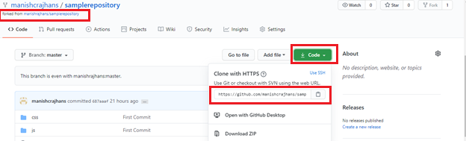
Forking the repository (Cont.…)
The newly opened page will look like this, now observe the repository name section where it shows forked from which repository, in the clone URL, you will see your username instead of owners username.

Slide 59



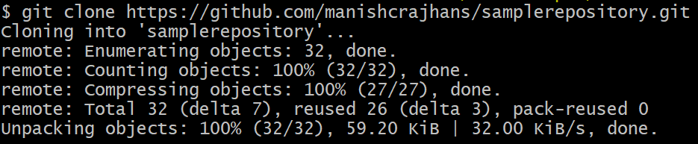
Forking the repository (Cont.…)
Now create a new directory and clone the repository into it with below commands.

Slide 60
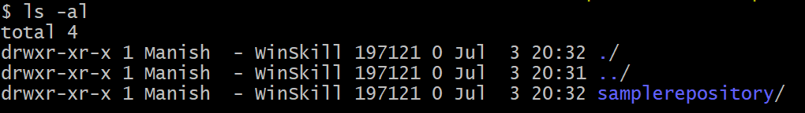


Forking the repository (Cont.…)
You can see the cloned repository
Navigate to the cloned repository.
Make the changes to Sample.txt
Now add the file modified into staging area as below.

Slide 61

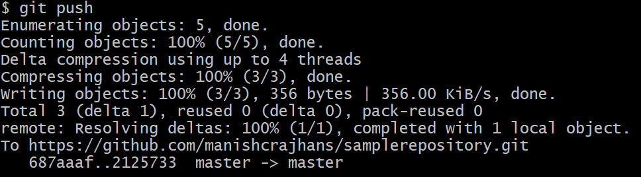
Forking the repository (Cont.…)
Commit the changes to local repository.
Now push the changes to remote repository.

Slide 62

Forking the repository (Cont.…)
Now you can see the added changes to the forked repository.

Slide 63


Forking the repository (Cont.…)
Now click on Pull Request.
It will open new page then click on New Pull Request button.

Slide 64

Forking the repository (Cont.…)
Now click on Create Pull Request.

Slide 65

Forking the repository (Cont.…)
Write comment and click on Create Pull Request.

Slide 66

Forking the repository (Cont.…)
Now the owner of repository will see the pull request. Click on the Pull requests.

Slide 67

Forking the repository (Cont.…)
Now click on the appearing pull request.

Slide 68

Forking the repository (Cont.…)
Click on the comment to see the changes.

Slide 69

Forking the repository (Cont.…)
Owner can view the changes before accepting or rejecting changes.

Slide 70
Forking the repository (Cont.…)
Owner can view the changes before accepting or rejecting changes. To accept or reject changes click on Review changes button.

Slide 71

Forking the repository (Cont.…)
Owner can view the changes before accepting or rejecting changes. To accept or reject changes click on Review changes button.

Slide 72


Forking the repository (Cont.…)
If there are no conflicts, then you can merge the pull request.
Now click on Confirm merge.
Now you can see the changes into the owners repository.

Slide 73

Branching the repository
Navigate to the samplerepository's master branch in GitBash (if not already there)
Now type git branch command to see what current branch you are in.
Now create the branch to git command by passing branch name to git branch command.

Slide 74


Branching the repository (Cont.…)
Now switch to the newly created branch with checkout command.
After switching to new branch, check the status.

Slide 75

Branching the repository (Cont.…)
Modify the sample.txt.
Now check the status of feature branch.
Now Add the file into staging area.

Slide 76



Branching the repository (Cont.…)
Committing changes to NewFeature branch.
Now check the status.
To merge the changes back to the master branch, checkout to the master branch.

Slide 77


Branching the repository (Cont.…)
Check the changes done from the NewFeature branch.
Now use merge changes back to the master branch.

Slide 78



Branching the repository (Cont.…)
You can check how many branches exists and which is current branch.
You can also delete the created branch.
Now you can check, the branch NewFeatures is deleted.

Slide 79

Checking the logs of repository
You can check the write logs of repository with git log command.

Slide 80

Signing up to Azure DevOps
Navigate to https://azure.microsoft.com/en-in/services/devops/ & click on Start with GitHub.

Slide 81

Signing up to Azure DevOps
After login, Click on New Organization.

Slide 82

Signing up to Azure DevOps
Provide the organization name and select the region and click on Contine.

Slide 83

Creating Project

Slide 84

Creating Project

Slide 85

Initializing the git repository

Slide 86

Connecting to Azure DevOps
Open the team explorer, Click on Connect as below, it will ask you for credentials.. Provide them and login.

Slide 87

Connecting to Azure DevOps
Open the team explorer, Click on Connect as below, it will ask you for credentials.. Provide them and login.

Slide 88


Cloning the Azure DevOps repository
After cloning repository, it is now available on you machine also as shown below.
In team explorer now click on New to create New solution in the cloned repository.

Slide 89

Committing changes to local repo
Click on Changes as shown below and you will be able to see all the changes.

Slide 90


Committing changes to local repo
Specify Commit message and click on Commit Changes.
Now Click on Synch to write the commited changes to Server. ^ Click on Push

Slide 91

Pushing changes to Azure DevOps
Now you can check that all the changes are pushed to Server.

Slide 92

Pushing changes to Azure DevOps
Now you can see, all the changes are written to Server.

Slide 93
Summary
In this lesson, you have learnt about:
Creating local & remote repository.
Cloning the repository
Forking the repository
Pushing the changes to the repository
Creating branch
Merging branch
Viewing write history.
Creating Azure DevOps account
Creating & Collaborating with Azure DevOps repository

Slide 94
Review Questions
_________ command is used to collaborate to the other users repository.
_______ command is used to view the right history.
_______ command shows the status of the repository.
_________ area contains all the tracked files.
_________ option in Visual Studio Team Explorer is used to synchronize the changes before pushing or pulling the content to or from Azure Devops repository.

